Slide 1
Lab 01 Recitation Getting to Know Your Robot: Let’s Get Moving!
Create basic motion functions for your mobile robot
Examine how odometry affects robot motion
Use encoders for position feedback to correct for odometry error in robot motion

Slide 2
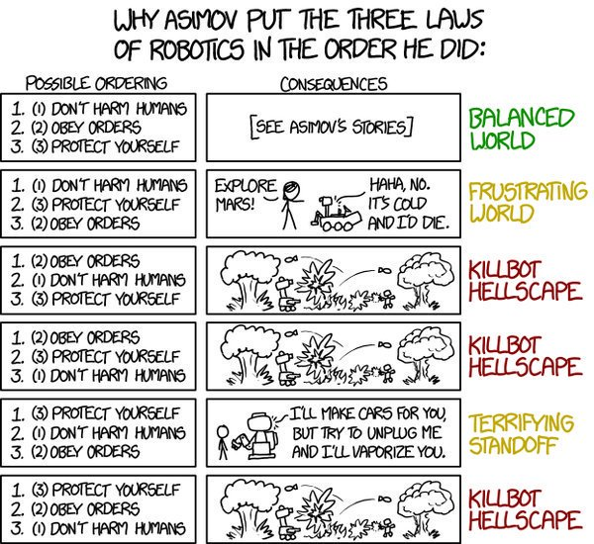
Asimov’s Laws

Slide 3

Science Communication, Life At Rose

Slide 4
Lab 01 – Motion Control
"Position"
Localization
Cognition
Global Map
Environment Model
Path
Local Map
Real World
Motion
Control
Perception
Environment
Notes:
Purpose
Introduce locomotion and odometry concepts
Install all necessary software and connect to the CEENBoT
Create your first program to get the robot moving
Examine problems with raw odometry for pose estimation
Locomotion
Two concerns in locomotion
Getting the robot to a particular location (goal)
Having the robot follow a trajectory
Navigation is concerned with getting to a goal
Trajectory planning (motion/path planning) is more difficult than moving the robot to a particular location. This is related to forward and inverse kinematics.
Optimal trajectory deals with finding the safest, shorts, or most efficient path

Slide 5
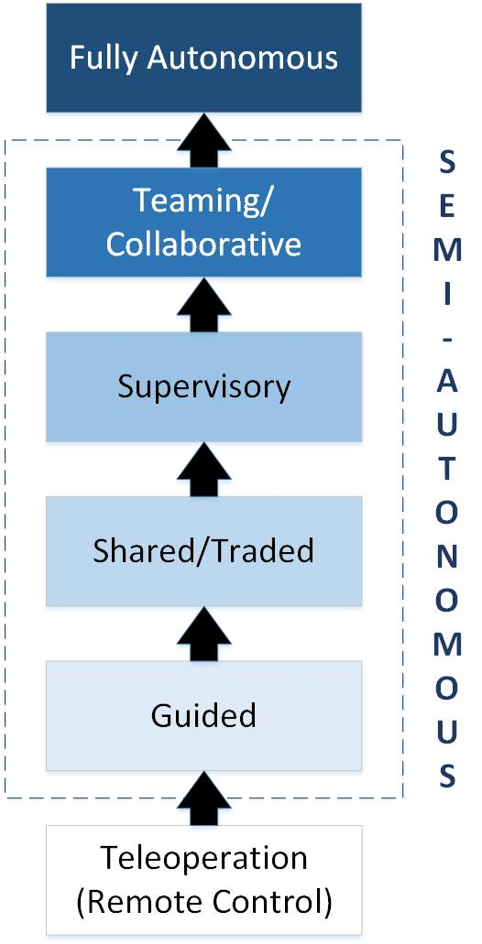
Levels of Control
Notes:
Fixed – robots do not move with respect to certain components of their environment;
Mobile – robots can travel in their environment by using various means of locomotion.
Teleoperation
In hostile or unsafe environments, human operators can teleoperate a mobile robot. The human performs localization and cognition, the robot provides motion control.
The human controls the robot
The human views the environment through the robot’s eyes
There is no need for artificial intelligence (AI)
Suited for tasks that are unstructured and not repetitive
Task requires dexterous manipulation, and hand-eye coordination
Task requires object recognition or situational awareness
Display technology does not exceed limitations of the communication link (bandwidth or time delays)
No constraints on the availability of trained personnel
Drawbacks are cognitive fatigue, simulator sickness, large time delay
Teleoperation is best suited for
In semi-autonomous robots, the human may control the robot sometimes. The robot is viewed as a peer or partner in the workspace with the human
In guided, the human provides waypoints to the robot which then executes using reactivity
In shared/traded control, the human provides the robot with the task but may interrupt the robot with feedback or perceptual inputs or interrupt execution if necessary
In supervisory control, the human is involved but routine or safe tasks are handled autonomously by the robot. Robot shares in planning.
In teaming/collaborative control, human and robot collaborate to decide on goals and sequencing
In fully autonomous control, the human initiates the task but does not interact after execution. Some robots share space with humans and their autonomy allows the robot to maintain a sense of position and navigate without human intervention

Slide 6

Robot Storage and Security
Don’t leave the robot alone in classrooms or hallways
Store it in lockers in the CSSE wing, DL207 hallway, or your car
You can check out a lock from me.
All parts damaged or lost must be replaced at cost

Slide 7
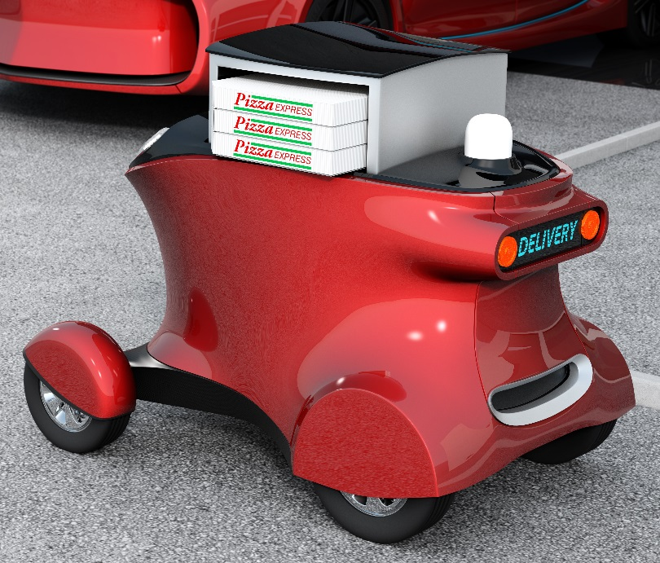
Robot Reality
No robot is perfect!
There will always be modeling, sensor and odometry error.
The robot is a tool to illustrate the concepts presented in class.
Your job is to use this imperfect tool to create the best possible solution to the lab assignments.
DO NOT MAKE REPAIRS OR UPDATES TO THE ROBOT, TAKE IT TO THE TECHNICIAN!
DO NOT PULL SENSORS & PROGRAMMER OUT BY CABLE USE CONNECTOR

Slide 8
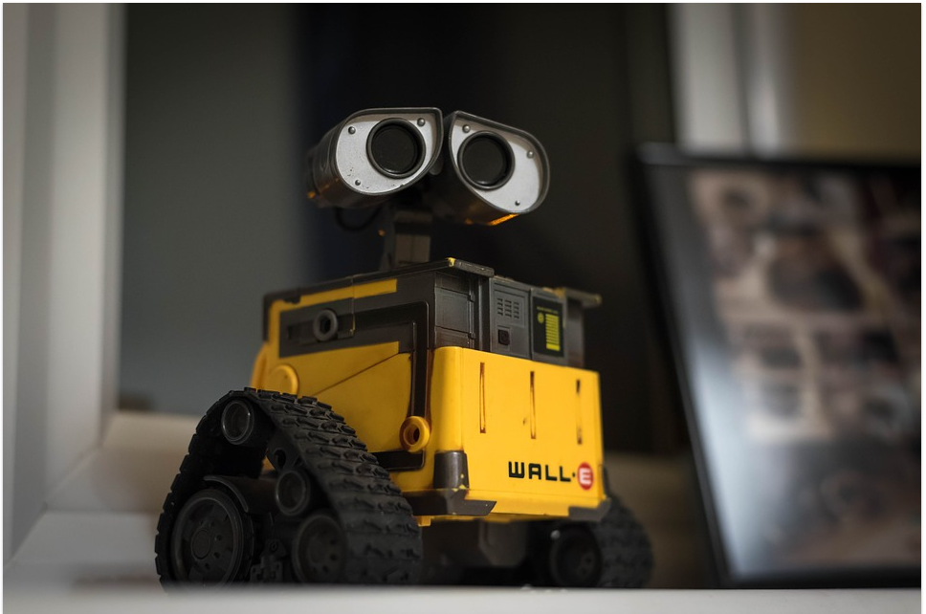
Test Stand
Do not drive the robot off a table!
Always test programs on the floor or have a test stand
Always code a delay at the beginning of the program or have it start with a button press
Use LEDs to indicate robot state
DO NOT DRIVE ROBOT OFF TABLE!

Slide 9
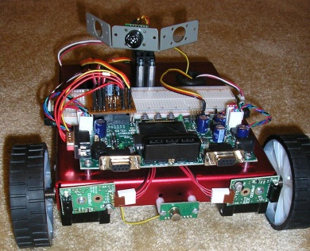
Your Robot
CEENBot w/ Arduino GIGA R1 WIFI
Bring the robot fully charged to class everyday!

Slide 10
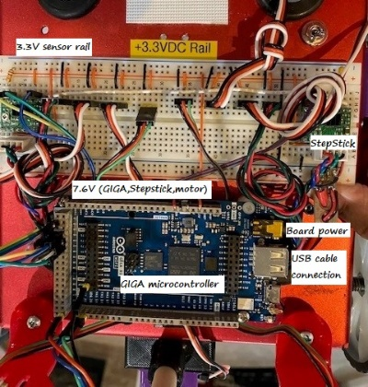
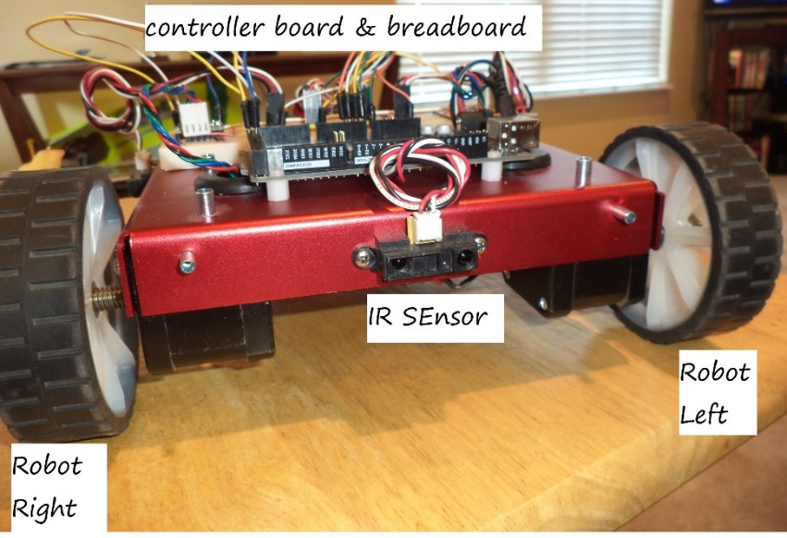
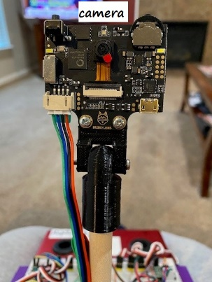
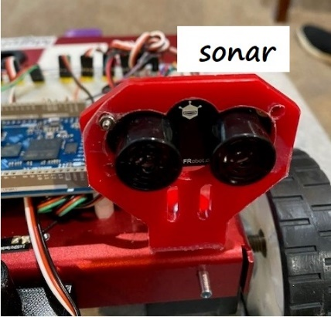
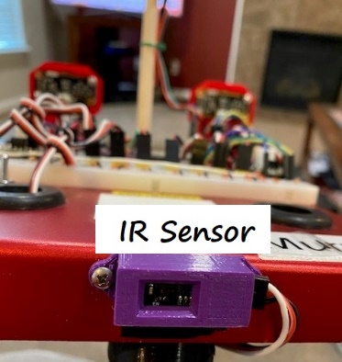
Robot Hardware
Arduino GIGA R1 WIFI microconroller
2 stepper motors
2 A4988 StepStick drivers
4 IR sensors
2 sonar Sensors
2 photocells
HuskyLens Camera
MPU6050 IMU

Slide 11

What is Odometry?
Odometry is a means of implementing Dead Reckoning
Determine a robot’s position based upon previous known position information given a specific course heading and velocity
Meant for short distance measurements
Requires periodically fixing errors

Slide 12

Odometry Advantages
Self-contained
Can get positions anywhere along curved paths
Always provides an “estimate” of position

Slide 13

Odometry Disadvantages
Requires accurate measurement of wheel velocities over time, including measuring acceleration and deceleration
Position error grows over time

Slide 14
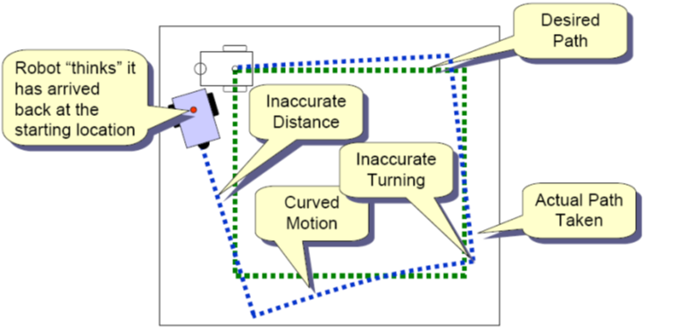
Odometry Error
Notes:
Mobile robot kinematics is the dynamic model of how a mobile robot behaves
Kinematics is a description of mechanical behavior of the robot for design and control
Mobile Robot Kinematics is used for:
Position estimation
Motion estimation
Mobile robots move unbounded with respect to their environment
There is no direct way to measure robot position
Position must be integrated over time
The integration leads to inaccuracies in position and motion estimation
Given wheel velocities at any given time, compute position/orientation for any future time
Advantages
Self-contained
Can get positions anywhere along curved paths
Always provides an “estimate” of position
Odometry Errors
Disadvantages
Requires accurate measurement of wheel velocities over time, including measuring acceleration and deceleration
Position error grows over time
Systematic
Unequal wheel diameters
Misalignment of wheels
Finite encoder resolution
Finite encoder sampling rate
Non-systematic
Travel over uneven floors
Unexpected objects in the floor
Wheel slippage due to
Over acceleration
Slippery floor
skidding
Imprecise measurements
Discrepancy with actual speed and turn angles
Inaccurate control model
Tracks/Wheels/Motors are not perfectly aligned or do not make contact at a single point
Immeasurable physical characteristics
Friction
Wobbling wheels
Surface is not perfectly smooth and hard
Sliding
Open loop control
Open Loop Control does not use sensory feedback, and the robot state is not fed back into the system
Feed-forward control
The command signal is a function of some parameters measured in advance
Feed-forward systems are effective only if
They are well calibrated
The environment is predictable and does not change

Slide 15
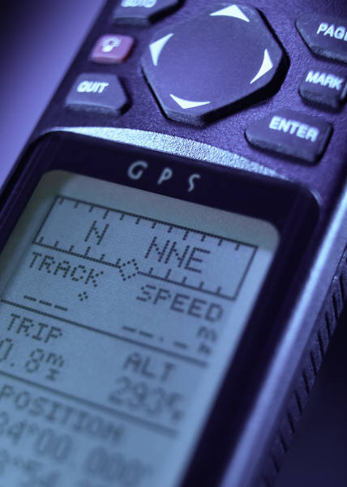
Odometry Errors
Systematic
Unequal wheel diameters
Misalignment of wheels
Finite encoder resolution
Finite encoder sampling rate
Non-systematic
Travel over uneven floors
Unexpected objects in the floor
Wheel slippage due to
Over acceleration
Slippery floor
Skidding

Slide 16
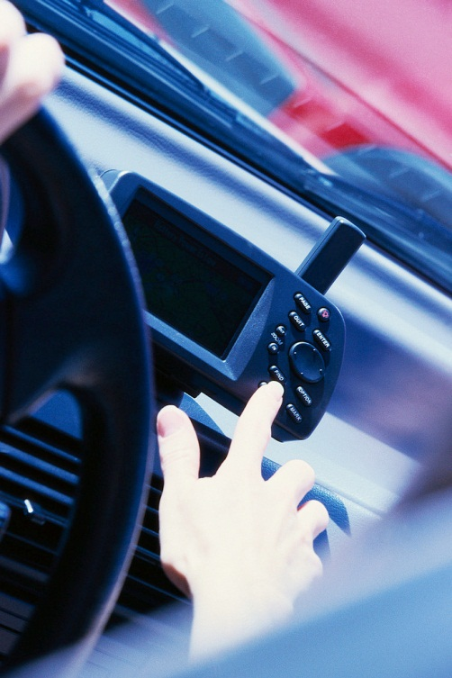
Odometry Errors
Imprecise measurements
Discrepancy with actual speed and turn angles
Inaccurate control model
Tracks/Wheels/Motors are not perfectly aligned or do not make contact at a single point
Immeasurable physical characteristics
Friction
Wobbling wheels
Surface is not perfectly smooth and hard
Sliding

Slide 17
Lab 01 Robot Motion Functions
Calibrate the robot wheels
Create motion functions
forward
reverse
stop
spin
turn
pivot
Create unique movements with no encoder
Circle
Figure 8
Create unique movements with encoder/IMU feedback
goToAngle
goToGoal
Square

Slide 18
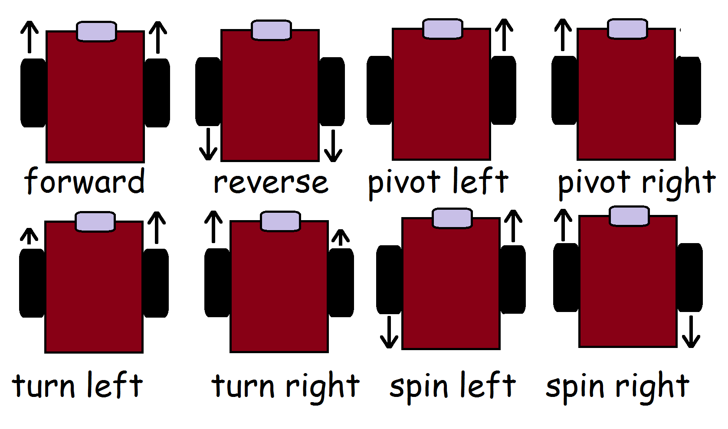
Robot Motions

Slide 19
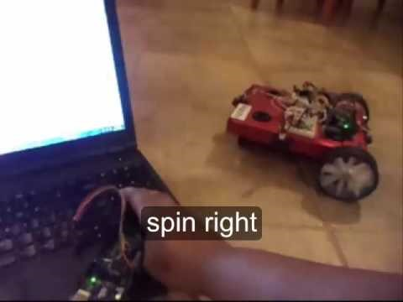
Keyboard Remote Control Drive

Slide 20

Lab 01 Demo – Basic Functions

Slide 21
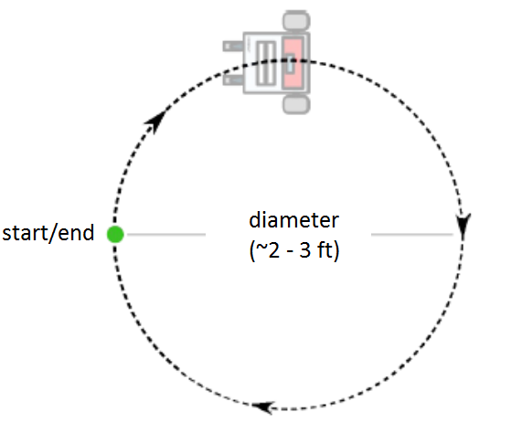
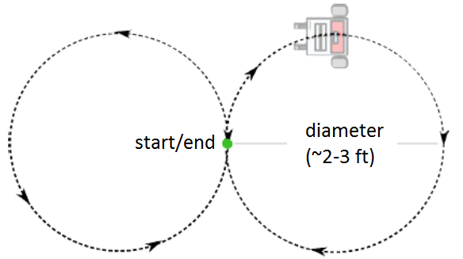
Lab 01 Circle and Figure 8
Notes:
<object width="560" height="315"><param name="movie" value="//www.youtube.com/v/huQSWZX1Glo?hl=en_US&amp;version=3&amp;rel=0"></param><param name="allowFullScreen" value="true"></param><param name="allowscriptaccess" value="always"></param><embed src="//www.youtube.com/v/huQSWZX1Glo?hl=en_US&amp;version=3&amp;rel=0" type="application/x-shockwave-flash" width="560" height="315" allowscriptaccess="always" allowfullscreen="true"></embed></object>

Slide 22
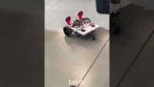
Lab 01 Demo – Circle and Figure 8

Slide 23
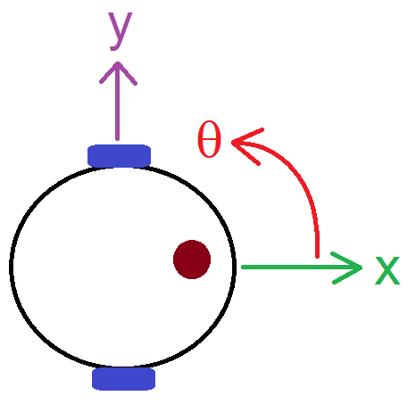
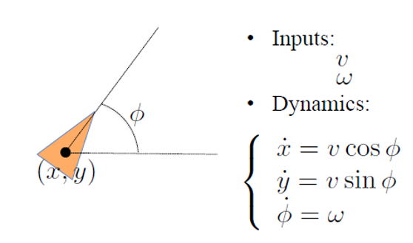
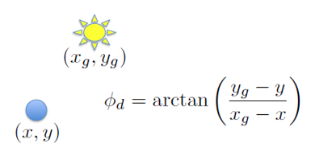
Lab 01 Go-To-Angle & Go-To-Goal
Notes:
<object width="560" height="315"><param name="movie" value="//www.youtube.com/v/huQSWZX1Glo?hl=en_US&amp;version=3&amp;rel=0"></param><param name="allowFullScreen" value="true"></param><param name="allowscriptaccess" value="always"></param><embed src="//www.youtube.com/v/huQSWZX1Glo?hl=en_US&amp;version=3&amp;rel=0" type="application/x-shockwave-flash" width="560" height="315" allowscriptaccess="always" allowfullscreen="true"></embed></object>

Slide 24
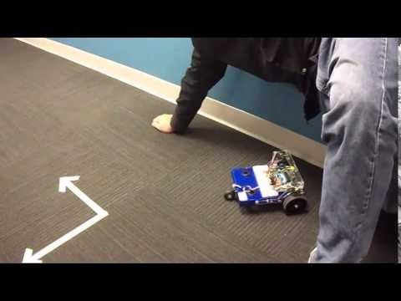
Go-To-Angle & Go-To-Goal

Slide 25
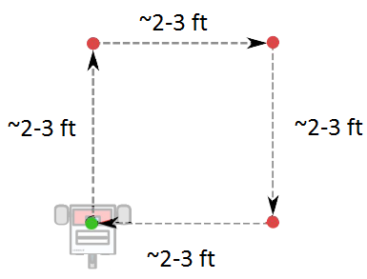
Lab 01 Square
Notes:
<object width="560" height="315"><param name="movie" value="//www.youtube.com/v/huQSWZX1Glo?hl=en_US&amp;version=3&amp;rel=0"></param><param name="allowFullScreen" value="true"></param><param name="allowscriptaccess" value="always"></param><embed src="//www.youtube.com/v/huQSWZX1Glo?hl=en_US&amp;version=3&amp;rel=0" type="application/x-shockwave-flash" width="560" height="315" allowscriptaccess="always" allowfullscreen="true"></embed></object>

Slide 26
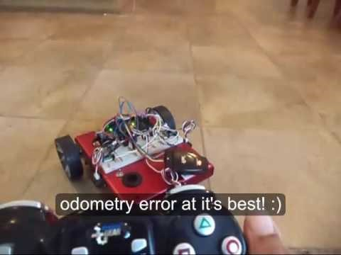
PlayStation Remote Control Drive

Slide 27
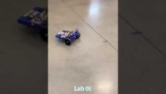
Lab 01 Demo – Square

Slide 28
Program Design
BEFORE you write any code, it is helpful to make a design
Why?
A little extra time spent on design can save a lot of time at implementation
Allows for a divide and conquer approach to development
Notes:
Can’t really read it on the slides, but it’s more of a callback to something they (hopefully) have seen before

Slide 29
Systematic Code Implementation
Organize and plan out your code before writing your code
Create a systematic approach to the logic
List the functions and variables
Comment your code as you go
To help with this, your pre-labs will be to make
Pseudocode
Flow Charts
State Diagrams
Subsumption Architecture

Slide 30
Pseudocode
An algorithm is a procedure for solving a problem in terms of actions to be executed.
Pseudocode is an artificial and informal language that helps programmers develop algorithms.

Slide 31
Pseudocode Example (Stop Watch)
3 states
Reset
Run
Stop
Initialize counter to 0
Initialize reset to 1
Initialize run to 0
Is the button pressed?
No, stay in current state, reset
Yes, increment counter, set reset to zero, set run to 1
Is the button pressed?
No, stay in current state, run
Yes, save final counter value, reset still 0, set run to 0
Is the button pressed?
No, stay in current state, stop
Yes, return to reset
Notes:
Can also be more like a programming language, if statements, etc… do example

Slide 32
AccelStepper Library
Review library documentation
Run the examples to understand how some of the functions work. These examples are in the AccelStepper library zip folder.
You can also access them from the IDE by click
File->Examples->AccelStepper->
Blocking
Bounce
ConstantSpeed
MultipleSteppers
MultiStepper
Overshoot
ProportionalControl
Quickstop
Random

Slide 33
Hints
Confirm robot wiring matches sample code, many students use these robots and sometimes it is different!
Understand which functions are blocking and which ones are not and what that means in your code
run() – accel, decel, no block
runSpeed() – constant speed, no block
runToPosition() – accel, decel, blocks
runSpeedToPosition() – constant speed, blocks
runToNewPosition() – accel, decel, blocks
Remember that the runtostop() function is used to increment steps when the motor has steps left.
Try using setMaxSpeed in place of setSpeed which sometimes does not change the wheel speed.
Note that some functions reset the speed to zero but you have to read the library documentation to determine which ones do that.
To get 2 different speeds on the wheels, try the following:
stepperRight.move(800);//move rt wheel 1 full rot fwd rel to curr pos
stepperLeft.move(1200);// move lt wheel 1.5 rot fwd rel to curr pos
//stepperRight.setAcceleration(7000);//try with and without acceleration
//stepperLeft.setAcceleration(10000);//try with and without acceleration
stepperRight.setMaxSpeed(1200);//set right motor speed
stepperLeft.setMaxSpeed(800);//set left motor speed
steppers.runSpeedToPosition();//run to position
To get 2 different speeds on the wheels, try the following:
positions[0]= 1200;
positions[1]= 800;
stepperRight.setMaxSpeed(800);//set right motor speed
stepperLeft.setMaxSpeed(1200);//set left motor speed
steppers.moveTo(positions);//set goal
steppers.runSpeedToPosition();//run to psoition

Slide 34
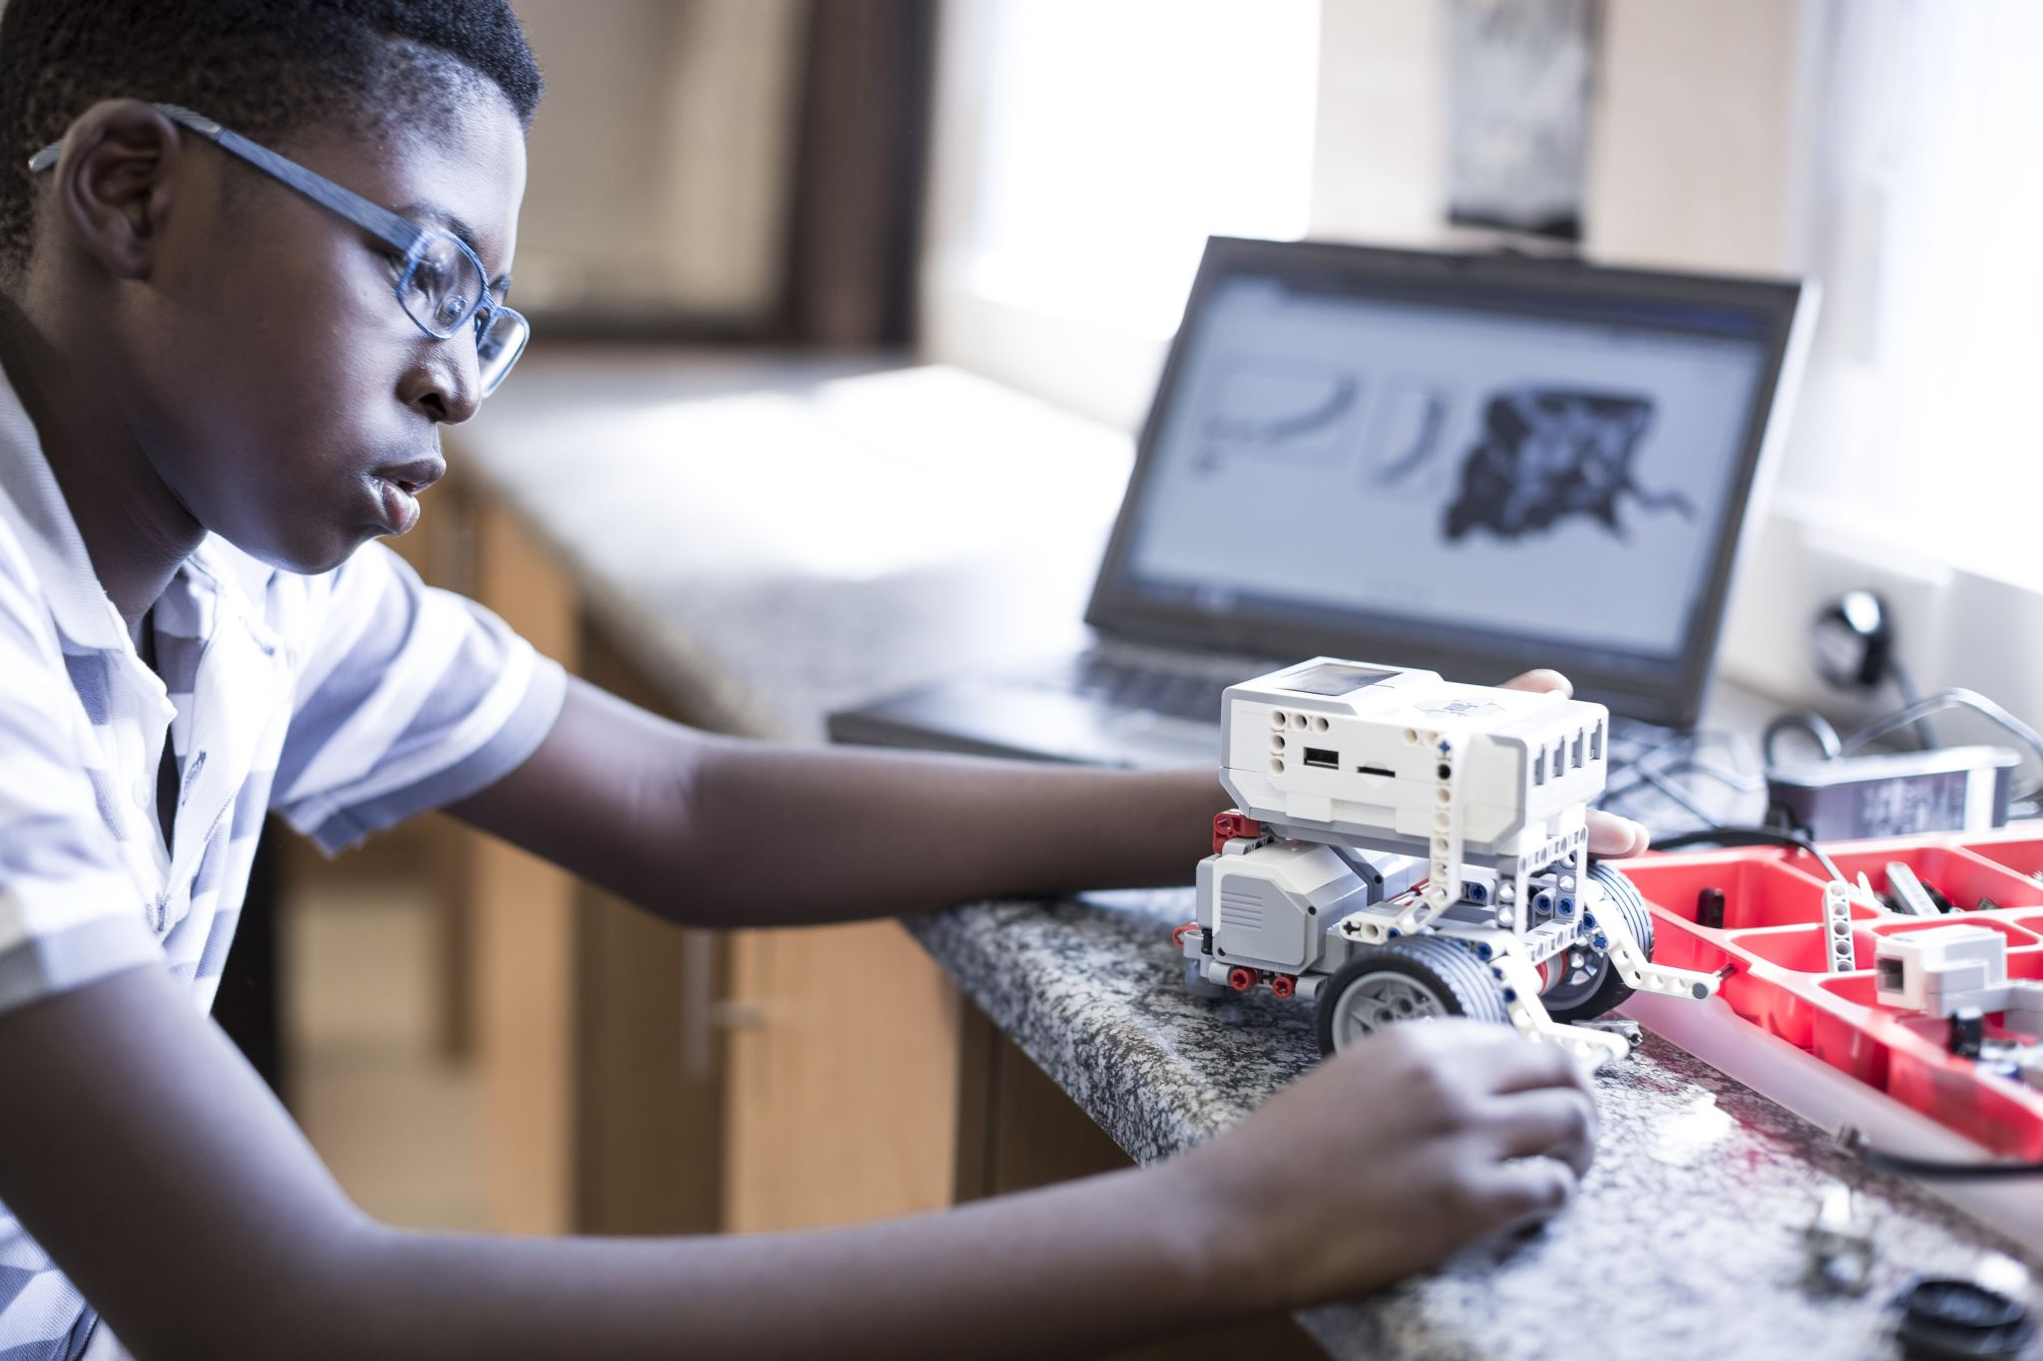
Test Encoder
Use code to test encoder clicks
How could you use these to correct for odometry error?

Slide 35
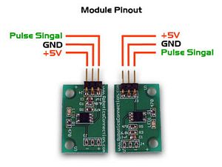
Wheel Encoder
A wheel encoder is attached to the shaft of a motor that drives the robot tracks and uses black to white transitions (pulses) to sense robot position or velocity.

Slide 36
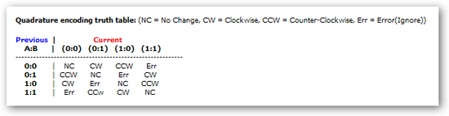
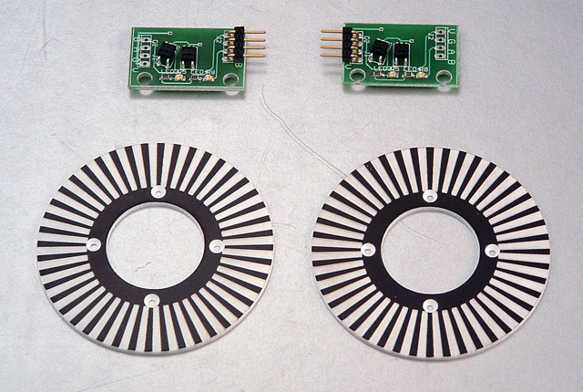
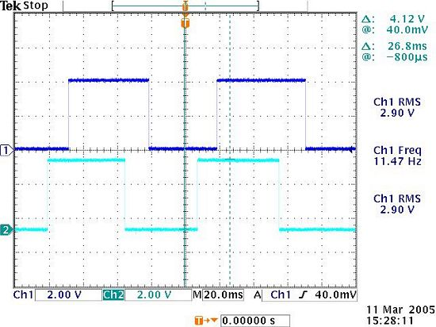
Quadrature Encoder
Used to sense a robot’s wheel
Position (distance traveled)
Velocity
Rotational direction
Outputs 2 square waves, 90 degrees out of phase
The sensor transitions from white to black when the wheel turns
The module requires +5V and ground and each channel (A, B) outputs +5V when it sees white and 0V when it sees black
The microcontroller reads to 0-5-0V pulse train to determine how far, how fast and what direction the robot’s motors are traveling

Slide 37

Quadrature Encoder, 2

Slide 38
Encoders: Measuring wheel distance
Relative position estimation is dependent on the measurement of the robot’s velocity
Optical encoders can be used on each wheel to measure angular position and or velocity
If the robot moves straight ahead, you can count encoder pulses to determine its new location
If 10 encoder pulses = 13 cm then distance can have an error up to 1.3 cm
This can be serious for short distances
Accumulated error can cause problems

Slide 39
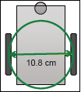
Encoders: Measuring spin angle
Assuming the robot turns around it’s center
(v₁ = -v₂)
If the robot has a diameter of 10.3 cm, the circumference is πd = π(10.8) = 33.93 cm
If each encoder pulse indicates a travel distance of 1.3 cm
(1.3 cm/pulse)/(33.93 cm)(360 °) = 13.79°/pulse
http://www.scs.carleton.ca/~lanthier/teaching/COMP4900A/Notes/5%20-%20PositionEstimation.pdf

Slide 40
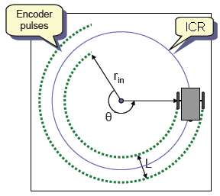
Encoders; Measuring turn angle
When the wheel velocities are not equal
Each wheel traces out a circle with a different circumference
The diameter of the robot L = 10.8 cm
Length of the inner arch (left wheel) → s₂ = r_{in} θ
Length of the outer arch (right wheel) → s₁ = (r_{in} + L)θ = s₂ + L θ
So θ = (s₁ – s₂)/L
The length of the arcs can be described in terms of the encoder pulses for the right (p₁) and left (p₂) wheels.

Slide 41
Encoders: Measuring turn angle, cont.
the difference in the encoder pulses, p_{Δ} = p₁ – p₂
Using this to find the change in the angle
θΔ = (p_{Δ})(1.3 cm/pulse)/10.8 cm
= 0.12037 p_{Δ} radians =(6.897) p_{Δ}°
Note that when the pulses of both wheels are equal (i.e. same velocity), θΔ = 6.897 p_{Δ}° = (6.897)(2p₁) = 13.79 p₁°
To find the (x, y) position of the robot substitute encoder pulses for velocities in the forward kinematic equations

Slide 42
Feedback Control Example
Given a robot with an arbitrary position and orientation and a predefined goal position and orientation. Design a control matrix for a real-state feedback controller to drive the pose error to zero.
The goal coordinates
of the robot
+
_
e
K
Transducer
(encoder)

Slide 43
Proportional integral derivative (PID) Control
This is a combination (sum) of the
proportional, derivative and integral terms
output = K_{p} ∗ i + K_{d} ∗ di/dt + K_{f} ∗ ∫ i(t)dt,
where i = error input

Slide 44
Proportional Control for Rotation Position of Wheel
In order to control rotational position of the of the robot you would pulse steps at a given speed
If the desired position = 100 encoder pulses
The controller will vary power to the motor based upon the error
The encoder will keep track of the shaft position

Slide 45
Proportional Control for Rotation Position of Wheel
Simple Proportional controller:
Command = 100 – encoder-counts
Initially, the error is 100
The motor turns on full speed
As it starts going, the error becomes
progressively smaller
Halfway, at position 50, the error is only 50
at that point the motor goes at 50% of full power
When it arrives at the intended position of 100, the error is zero
the motor is off

Slide 46
Proportional Control for Rotation Position of Wheel
Proportional gain:
Command = 5∗ (100 – encoder-counts)
The response will be tighter
There will be a more aggressive resistance to being turned away from the set point
The wheel reaches the set point position faster
The system is critically damped

Slide 47
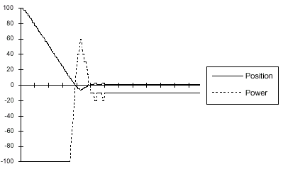
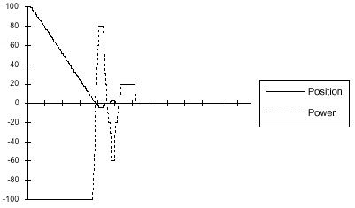
Proportional Control
power= P_{gain} * (0 - counts)
P_{gain}=10:
System overshot the zero point, and had to turn around
Offset Error: System did not stabilize at the goal
Power command too small to activate the motor
P_{gain}=20: should ameliorate the offset problem
Offset error is solved
Oscillation: the system overshoots three times
P_{gain} = 10
P_{gain} = 20
http://www.cse.unr.edu/~monica/Courses/CPE470-670/cpe470-670-sp05.html

Slide 48
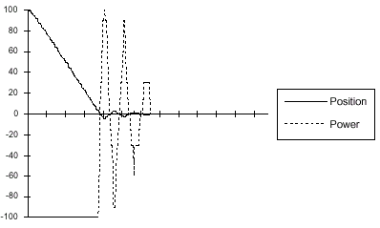
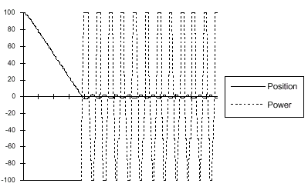
Proportional Control
power= P_{gain} * (0 - counts)
P_{gain}=30:
Oscillation problem is more pronounced;
The response is underdamped
P_{gain}=50:
Oscillation behavior has taken over
System cannot stabilize at the set point
A small error generates a power command that moves the system across the set point
The system is undamped
P_{gain} = 30
P_{gain} = 50
http://www.cse.unr.edu/~monica/Courses/CPE470-670/cpe470-670-sp05.html

Slide 49
Derivative Control
Setting gains is difficult, and simply increasing the proportional gain does not remove oscillations
The system needs to be controlled differently when it is close to the desired state and when it is far from it
The momentum of the correction carries the system beyond the desired state, and causes oscillations
momentum = mass ∗ velocity
Solution: correct the momentum as the system approaches the desired state

Slide 50
Controlling Velocity
Momentum and velocity are directly proportional therefore we can control the momentum by controlling velocity
As the system nears the desired state, we subtract an amount proportional to the velocity:
- (gain ∗ velocity)
Derivative term (velocity is the derivative of position)
A controller that has a derivative term is called a derivative (D) controller

Slide 51
Derivative Control
A derivative controller has an output proportional to the derivative of its error = r input i:
output = K_{d} ∗ d (error input)/dt
K_{d} is a proportionality constant
The intuition behind derivative control:
Controller corrects for the momentum as it approaches the desired state
Slow down the robot and decrease the turning angle while getting closer to the desired state
Decrease the motor power while getting closer to the desired state

Slide 52
Proportional-Derivative (PD) Control
Proportional-derivative control
Combination (sum) of proportional and derivative terms
output = K_{p} ∗ (error input) + K_{d} ∗ d(error input)/dt
PD Control is used extensively in industrial process control
Combination of varying the power input when the system is far away from the set point, and correcting for the momentum of the system as it approaches the set point is quite effective

Slide 53
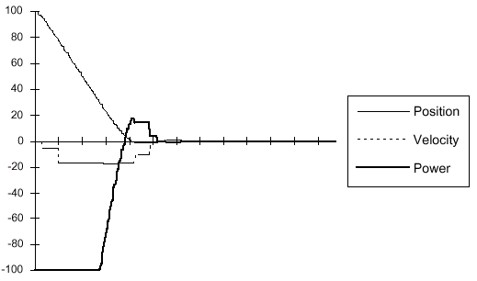
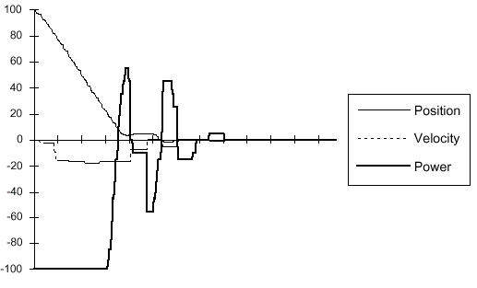
Proportional-Derivative Control
power= P_{gain} * (0 - counts) - D_{gain} * velocity
P_{gain}=4, D_{gain}= 1:
Overshoot is minimized, no oscillatory behavior at all
P_{gain}=10, D_{gain}= 5:
Unstable; D_{gain} is too large
Position graph: controller “puts on the brakes” too hard and the system stops moving before the destination setpoint (between the 0.8 and 1.0 second mark)
When the velocity hits zero, the proportional gain kicks in again and the system corrects
P_{gain} = 4, D_{gain} = 1
P_{gain} = 10, D_{gain} = 5
http://www.cse.unr.edu/~monica/Courses/CPE470-670/cpe470-670-sp05.html

Slide 54
Integral Control
errors accumulate as the robot is running a longer time
How can we solve the problem?
Sum up the errors and compensate for them when they become significantly large
The control system can be improved by introducing an integral term
output = K_{i} ∗ ∫ (error input)dt
K_{i} = proportionality constant
Intuition:
System keeps track of its repeatable, steady state errors
These errors are integrated (summed up) over time
When they reach a threshold, the system compensates for them

Slide 55

Wire sensors to MegaBot

Slide 56
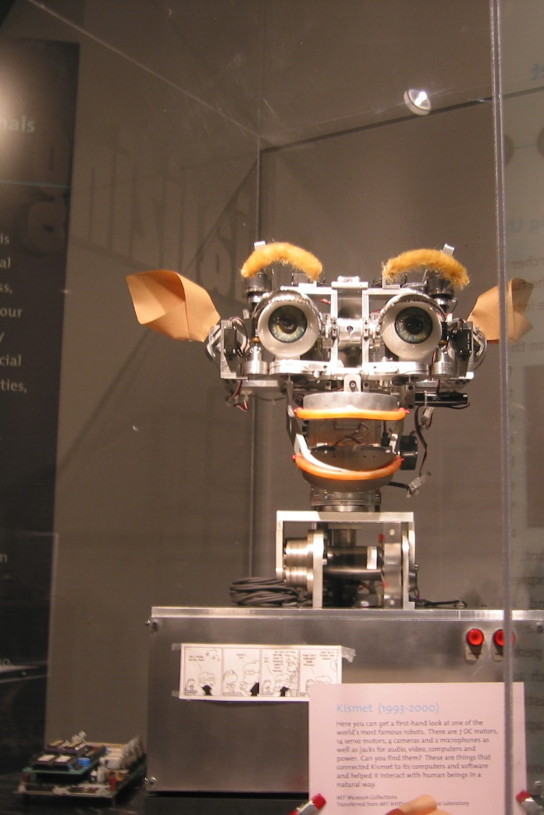
Demonstration Requirements
Robot Motion Functions – DUE NEXT CLASS
Put all motion functions in the loop() function
Run them all back to back with a 5 second delay in between
Forward, delay, Reverse, delay, Spin left, delay, spin right, delay, turn left, delay, turn right, delay, pivot left, delay, pivot right, delay, stop
Create functions that take an input to create a
Circle
Figure Eight
Square
GoToAngle
GoToGoal
DUE IN ONE WEEK
I will give you the input for the functions during the demonstration so make sure your code is written to support this.
Demo due one week from today
This Photo by Unknown Author is licensed under CC BY-SA

Slide 57

Code Requirements
All code must have a heading with
the name of the file,
a description of the functionality,
description of main functions and variables
names of the authors
dates of last revision.
Use single-line comments or delimited comments for all functions
Code and Memo due Sunday after demo

Slide 58

Code Requirements
Code must be modular with functions called from the void loop() function
Code must use local and global variables with descriptive names, no MAGIC NUMBERS
Code must use defines or constants for values that will not change during run time

Slide 59
Header Comments
Header comment should have filename, author name, date created
Header comments include one sentence description of program
Header comments includes name and one sentence description of main functions
All old code and comments removed

Slide 60
In-Line Comments
You should have block or in-line comments to introduce functions
You should have block or in-line comments to introduce for or while loops
You should have block or in-line comments to introduce if conditional statements
You should have block or in-line comments to introduce switch conditional statements
Add any other relevant in line comments

Slide 61
Code Organization
Organize code by lining up braces, tabs, functions
Use global and local variables, constants for common numeric values (no magic numbers)
Give functions logical names (i.e root2)
Use functions, arrays, conditionals, as much as possible to re-use and organize code

Slide 62
Magic Numbers
#include <Servo.h> // include servo library
#include <LiquidCristal.h> //include LCD library
#define SERVO_CONTROL 9 //attach servo to pin 9
Servo myServo; //myServo is a Servo object
//define LCD pins
#define LCD_RS 12
#define LCD_E 11
#define LCD_DB4 5
#define LCD_DB5 4
#define LCD_DB6 3
#define LCD_DB7 2
#define NCOLUMNS 16
#define NROWS 2
LiquidCrystal myLCD(LCD_RS, LCD_E, LCD_DB4, LCD_DB5, LCD_DB6, LCD_DB7);
//myLCD is an LCD object
#define MOTOR_CONTROL 10 //attach DC motor to pin 10
#define BUZZER 6 //attach buzzer to pin 6
#define REDLED 8 //attach Red LED to pin 8
#define TEMPERATURE A0 //attach temp snsr to analog 0
#define PHOTOCELL A1 //attach photo resistor to analog 1
#define BUTTON 7 //attach button to pin 7
No Magic Numbers
Any Number Is A Magic Number!

Slide 63
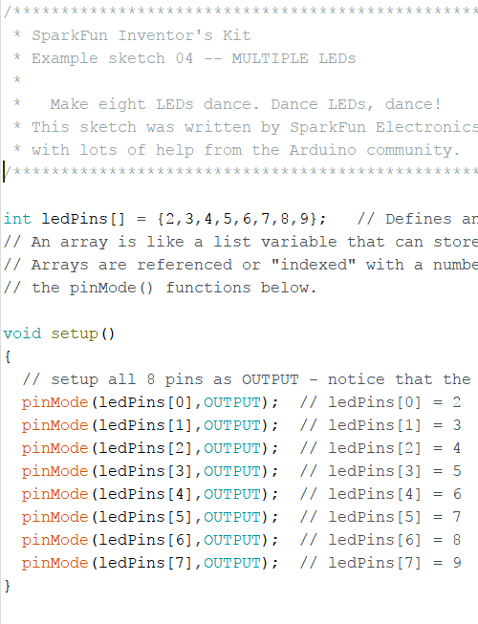
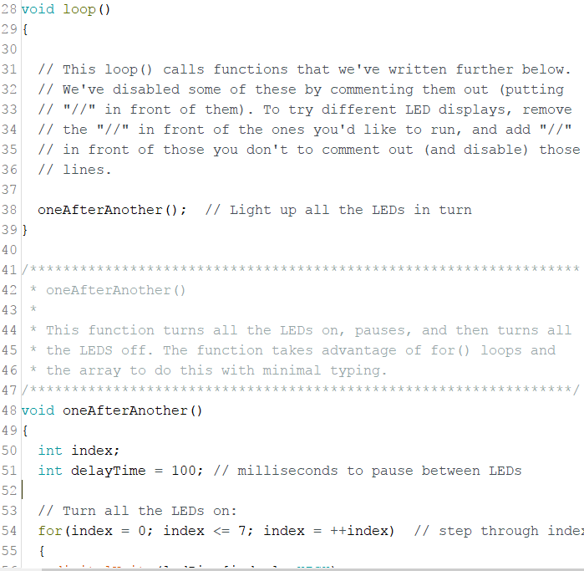
Commenting Sample
Header comment
Function comment
Function call
Block comment
In-line comment
Notes:
Header comment should include program name, author name, date created, describe what the program does and summarizes any key functions, variables, etc.
Function comment should describe what a function does and should explain any variables passed or returned from the function.
Function call is used in a separate function to use code, this keeps your code more organized and efficient and improves readability, give functions a descriptive name
A block comment is used for several lines of comments and can be implemented with // or the /* and */ pair
In-line comment will describe a line of code to make it more clear, note that this one is a variable that holds a number to avoid magic numbers and also makes it reusable in several places

Slide 64
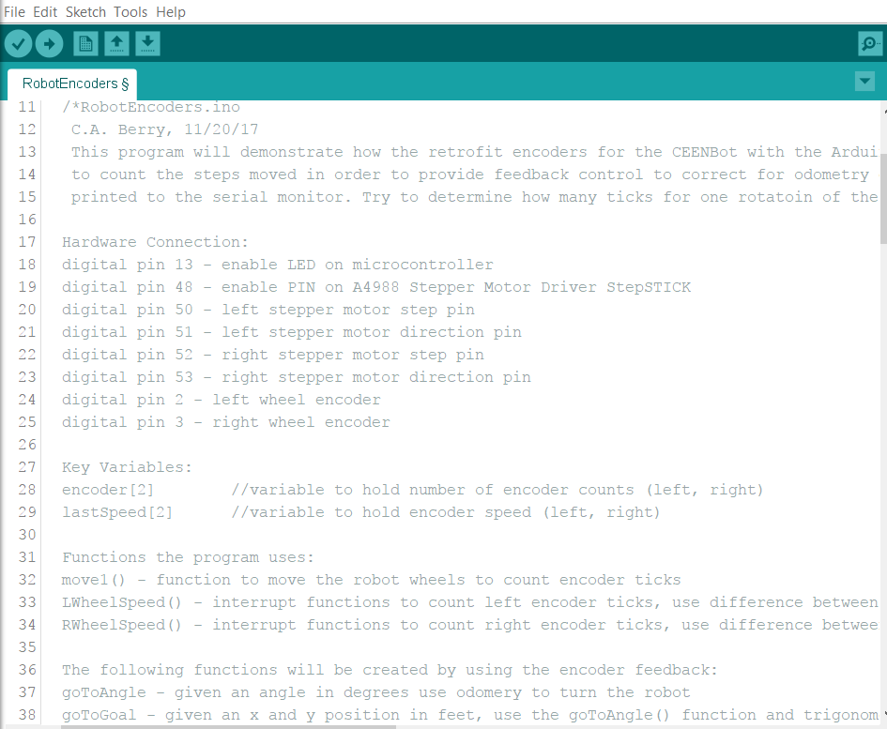
Header Comment Example
Filename
Date Created
Author
Program Desc
Function Desc
Variable Desc

Slide 65
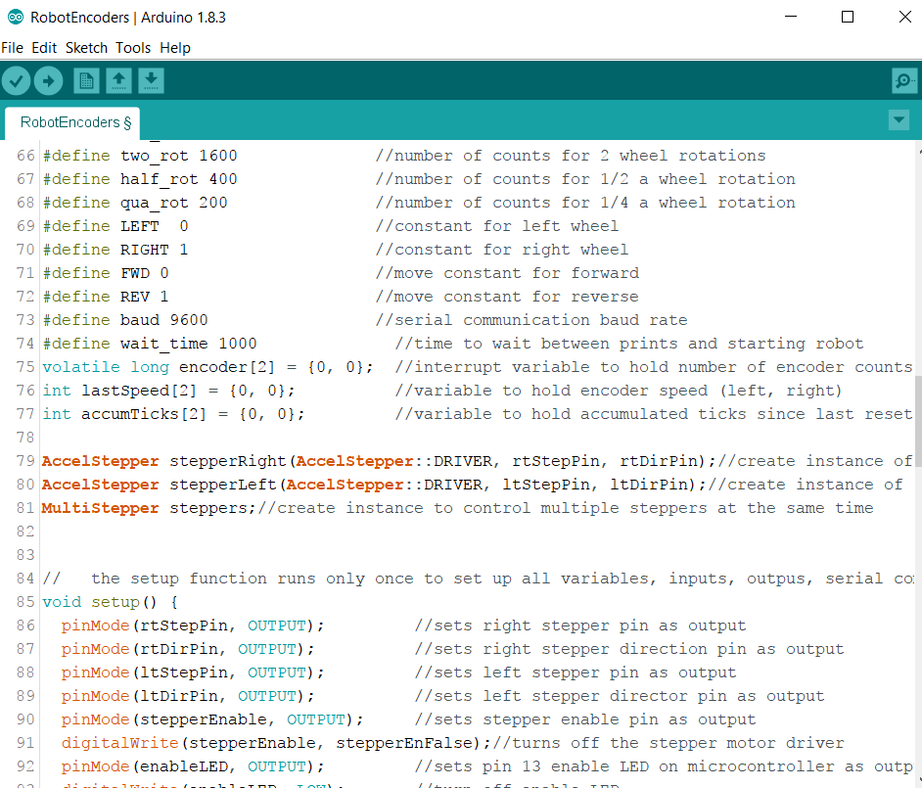
In-line & Block Comments
In line comments for variables
Function Block comment

Slide 66
Code Format
Rename example code to “RobotName-Lab#.ino”
Comment code as necessary
Header Comment with
Program Name
Authors
Date Created
Program Description
Key functions created with function
Use functions and variables to organize your code to flow in a logical fashion
Create logical function, variable and constant names
No magic numbers, use constants to represent values
In line and block comments to explain main body of program
Remove all instructional comments
Modify code to meet lab requirements
Use lab code as an example of proper commenting, organization and modularity

Slide 67
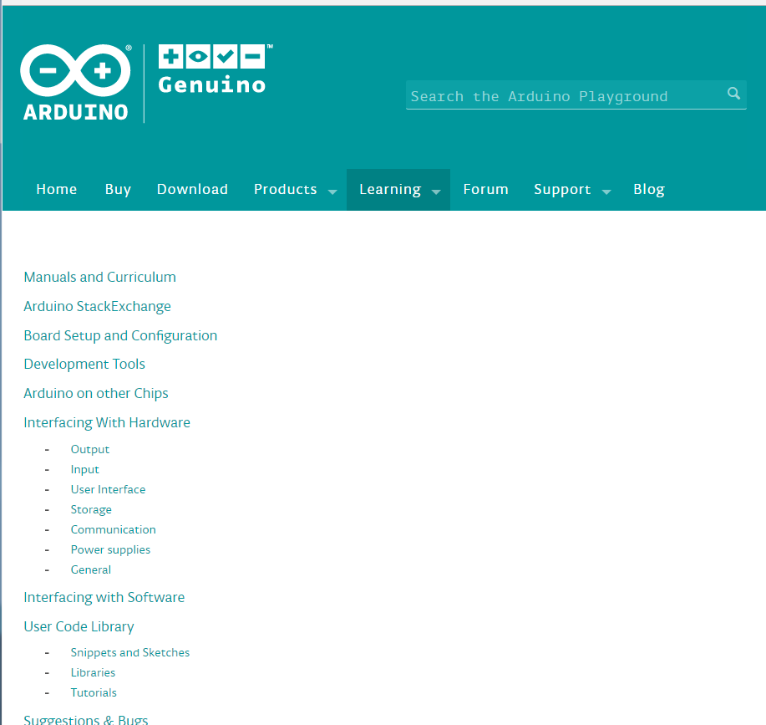
Arduino Programming Help
www.arduino.cc
Notes:
"C:\Program Files (x86)\Arduino\arduino.exe“
playground.arduino.cc

Slide 68
Pre-Lab 01
Read A Primer on Odometry and Motor Control
Review AccelStepper Library
Use pseudocode to create the algorithms for the following functions
go-to-angle(int angle)
go-to-goal(int x, int y)
moveSquare(int side)
moveCircle(int diam, int dir)
moveFigure8(int diam)
Upload file to GradeScope from Moodle.
Pre-lab 01 due at the beginning of the next class
Lab 01 Demo due next class and in one week

